Slide 1


Adding CSS to Our Website
By: Dalia Ihab

Slide 2



CSS Embedding
Inline: Inline CSS contains the CSS property in the body section attached with the element known as inline CSS.

Slide 3
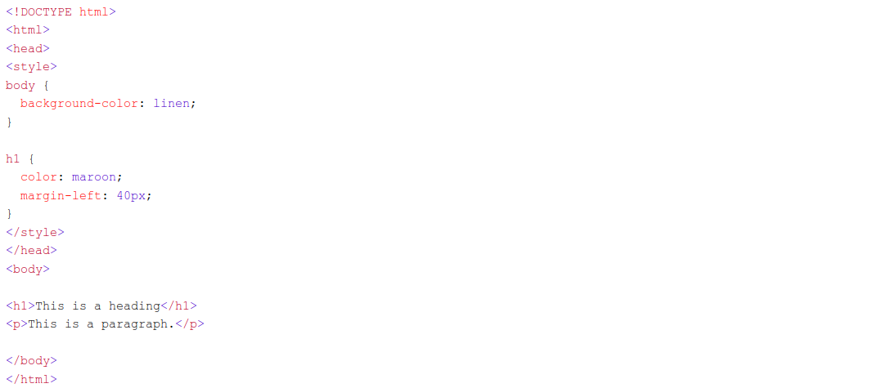
CSS Embedding
Internal or Embedded: The CSS ruleset should be within the HTML file in the head section i.e the CSS is embedded within the HTML file.

Slide 4
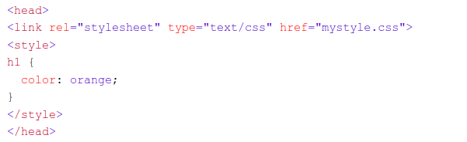
CSS Embedding
External: External CSS contains a separate CSS file that contains only style property with the help of tag attributes

Slide 5
Priority based on CSS selector
High
Inline CSS
Internal CSS
External CSS
Low

Slide 6


Next
CSS Selectors

